Slide 1
Week6 Project
Kaiye Chen

Slide 2
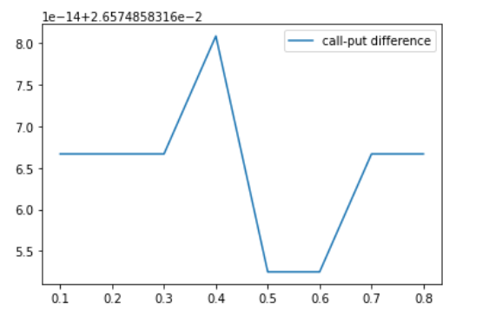
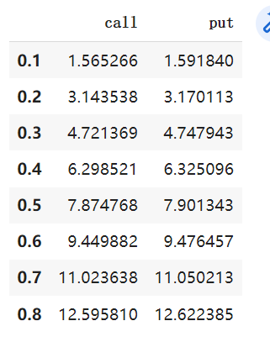
Problem1: Results
Price increases, implied volatility increases
No obvious relation of put-call spread

Slide 3
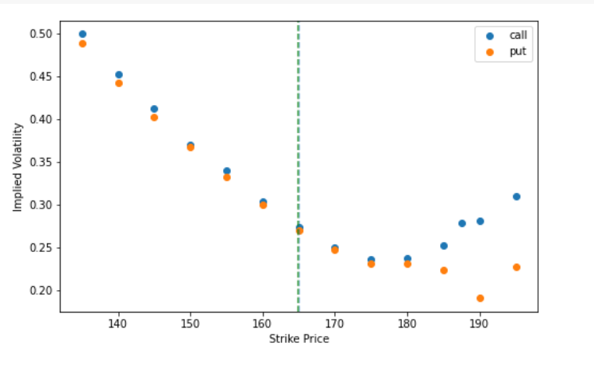
Problem2: Volatility smile & Gambler’s Fallacy
Volatility smile: at-the-money lowest
History: money “crash” in 1980s
Theory: Gambler’s Fallacy

Slide 4
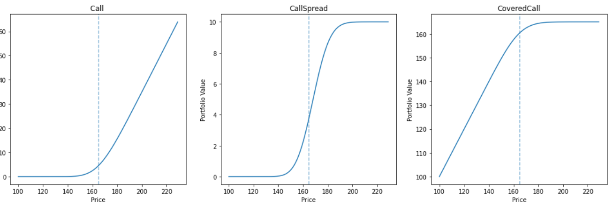
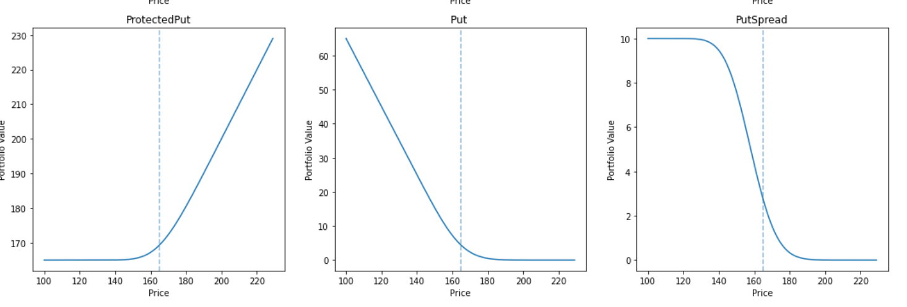
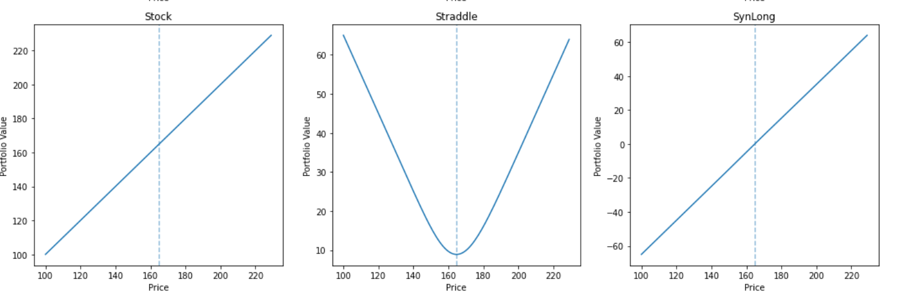
Problem3: Several Synthetic Options

Slide 5
Problem3: Synthetic Method
1.Call Spread: long call with a lower strike price and one short call with a higher strike price
2.Put Spread: 2 puts in different direction but in the same underlying asset
3.Covered Call: stock is purchased and calls are sold.
4.Protected Put: stock is purchased and puts are bought.
5.Straddle: buying both a put option and a call option
6.Synlong: A strategy that repeats the stock payoff.

Slide 6
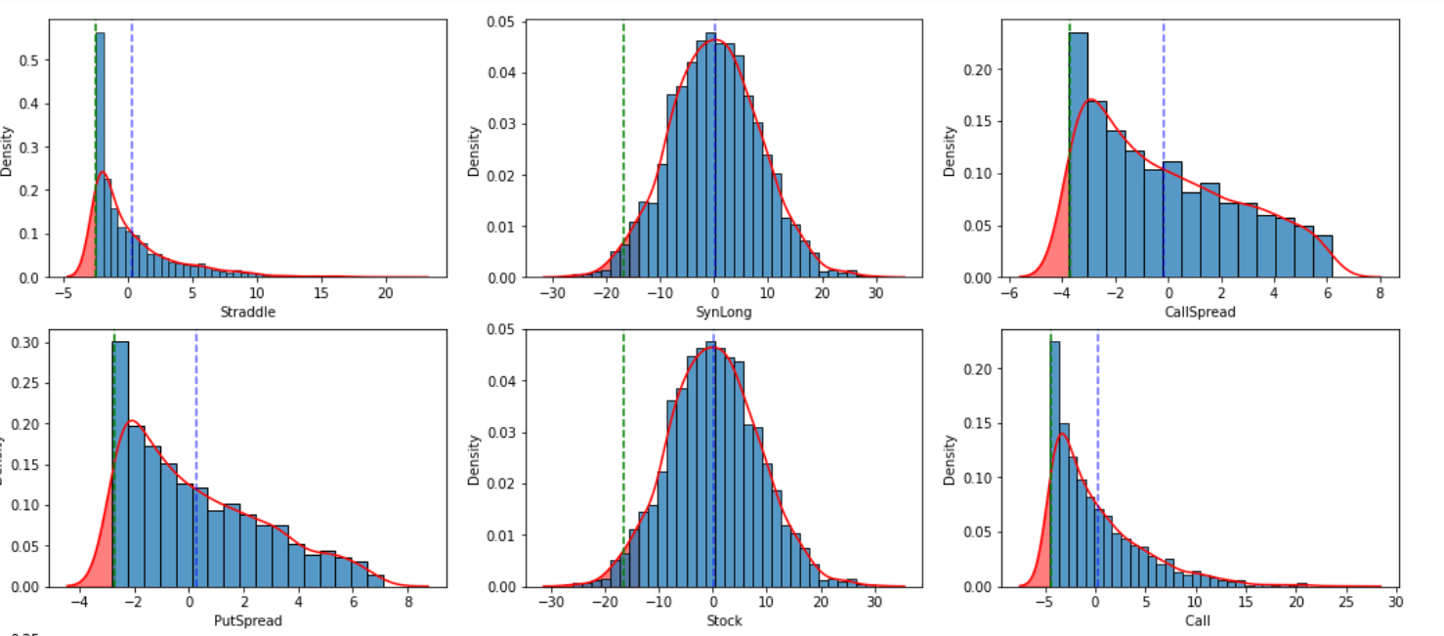
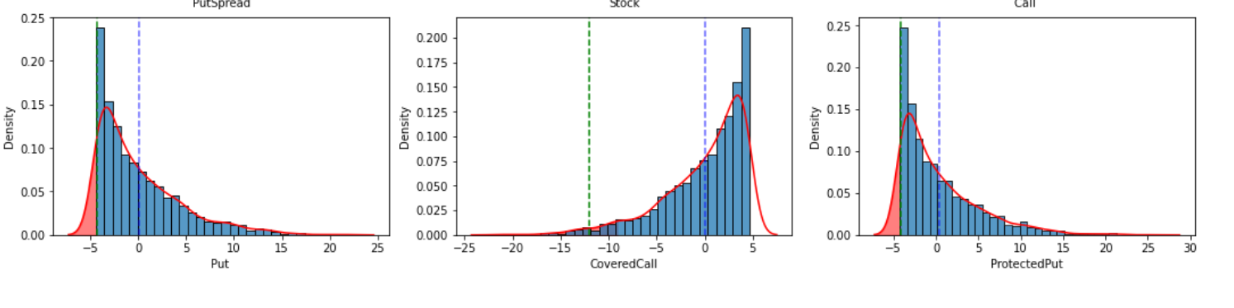
Problem3: Profit&Loss, ES, VaR
1.Call/Put Strategy: similar , positive average payoff
2.Covered call/Protected put: similar , return close to 0 , lowest risk
3.Straddle: high density to loss a small amount,relative low ES and VaR
4.SynLong. The most risky portfolio, extremely high VaR and ES

